Slide 1
SENSOR(s) MEASUREMENT PROJECT
MPU6050 Module DHT-11 Ultrasonic Water Level Detection
By: Lucas Scheibal, Lin Shen, Yiyang Chen, Cheng Chen and Iretomiwa Idowu

Slide 2
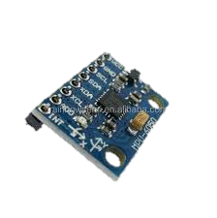
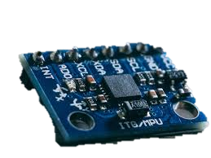
MPU6050 Module
2
Working Principle
The MPU6050 is a multi-axis accelerometer and gyroscope that measures linear acceleration and angular acceleration respectively.
The accelerometer measures linear acceleration by using tiny systems to see how close to plates are to each other.
The gyroscope measures angular acceleration and it does this with a continuously oscillating mass and the known physics of the Coriolis effect.

Slide 3
Important Characteristics
Range
Resolution
3
Specs Table/
Datasheet
Accelerometer ODR range | 8kHz to 1.25Hz
Accelerometer Range | ±2g, ±4g, ±8g, ±16g
Accelerometer sensitivity | at ±2g: 16384 LSB/g at ±4g: 8192 LSB/g at ±8g: 4096 LSB/g at ±16g: 2048LSB/g
Gyroscope ODR range | 8kHz to 1.25Hz
Gyroscope range | ± 250, ± 500, ± 1000, ± 2000 dps
Gyroscope sensitivity | at ±250dps: 131 LSB/dps at ±500dps: 65.5 LSB/dps at ±1000dps: 32.8 LSB/dps at ±2000dps: 16.4 LSB/dps
Sensitivity
Linearity
Repeatability
Accuracy
Precision

Slide 4
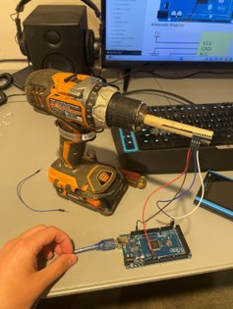
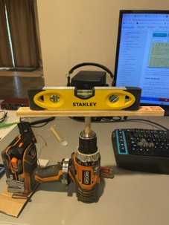
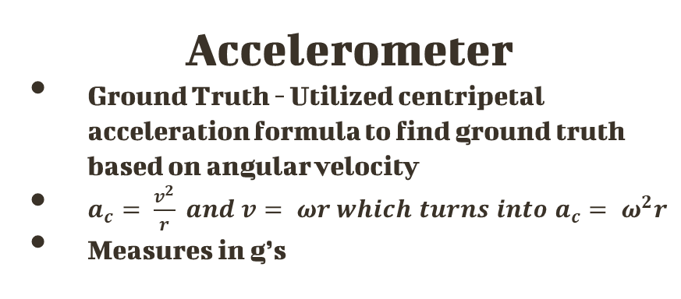
Measurement Process
4
Gyroscope
Ground Truth- Determined angular velocity using supplied encoder
Assumed higher accuracy from encoder dur to counting instead of measuring
Measured in degrees per second
Accelerometer
Ground Truth - Utilized centripetal acceleration formula to find ground truth based on angular velocity
$a_{c}= \frac{v^{2}}{r} and v= ωr which turns into a_{c}= ω^{2}r$
Measures in g’s

Slide 5
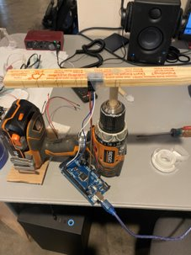
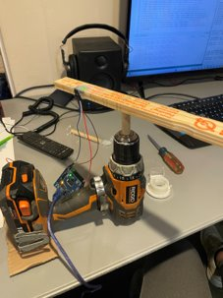
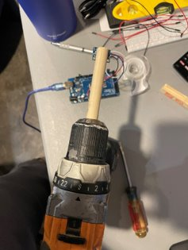
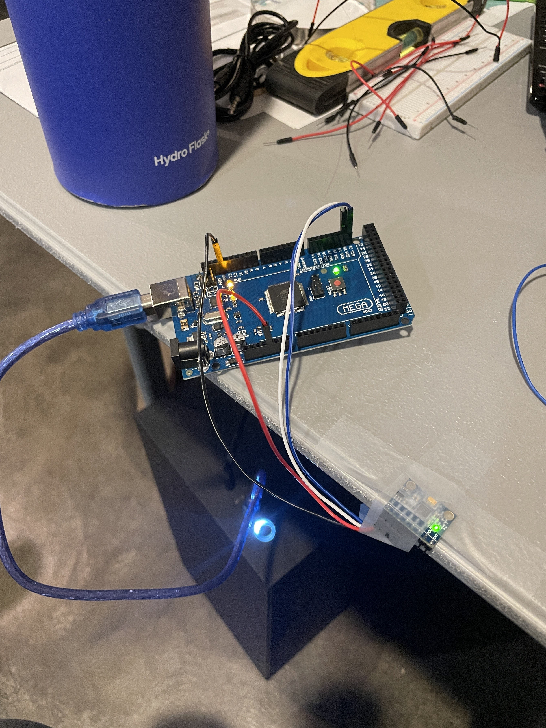
More pictures of the testing Setup
5
Accelerometer Testing Setup
Gyroscope Testing Setup

Slide 6
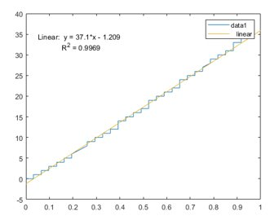
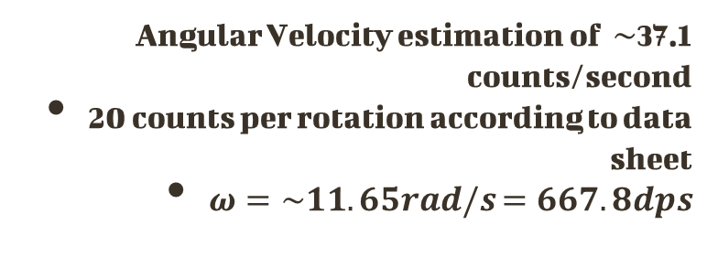
6
Ground Truth
Ground Truth Result
Ground
Truth Value
The goal was to obtain angular velocity of a drill at different points
Issues with encoder being unable to keep up
Issues with recreating speeds
Angular Velocity estimation of $\sim$37.1 counts/second
20 counts per rotation according to data sheet
$ω=\sim 11.65rad/s$ $=667.8dps$

Slide 7
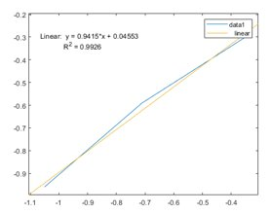
Sensor Characteristics
7
Accelerometer Results
Repeatability
Measurements along Y axis
1 inch: [-0.28g, -0.29g, -0.33g] with average of -0.30g, expected -0.35g
2 inch: [-0.61g, -0.54g, -0.63] with average of -0.59g, expected -0.71g
3 inch: [-0.84g, -0.92g, -1.13g] with an average of -0.96g, expected -1.05g
Range
Unable to test due to wires
Sensitivity
Expected
Resolution
Needed to accurately control

Slide 8
8
Summary of findings and Improvements
Use 12V motor and something like PWM to control angular velocity
Verify with better encoder
Mount motor at exactly horizontal or vertical
Power Arduino without computer (battery)
Utilize onboard storage for results when set up is moving

Slide 9
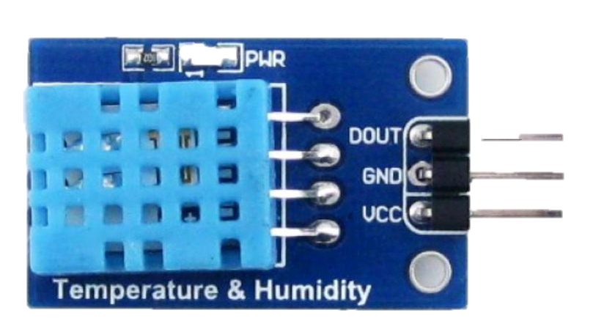
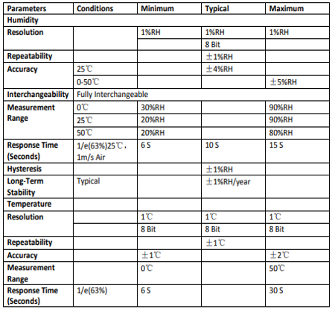
DHT-11 Module
9
Important Characteristics and Specs Table
The DHT-11 is a temperature and humidity sensor. It features a resistive-type humidity measurement component, a NTC temperature measurement component and an 8-bit microcontroller. Its primary purpose is to measure temperature and humidity.
Working Principle
The DHT11 sensor consists of a capacitive humidity sensing element and a thermistor for sensing temperature.

Slide 10
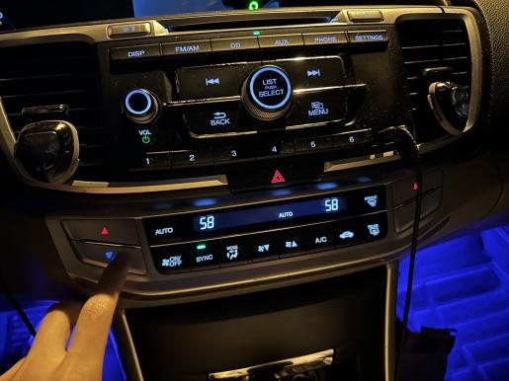
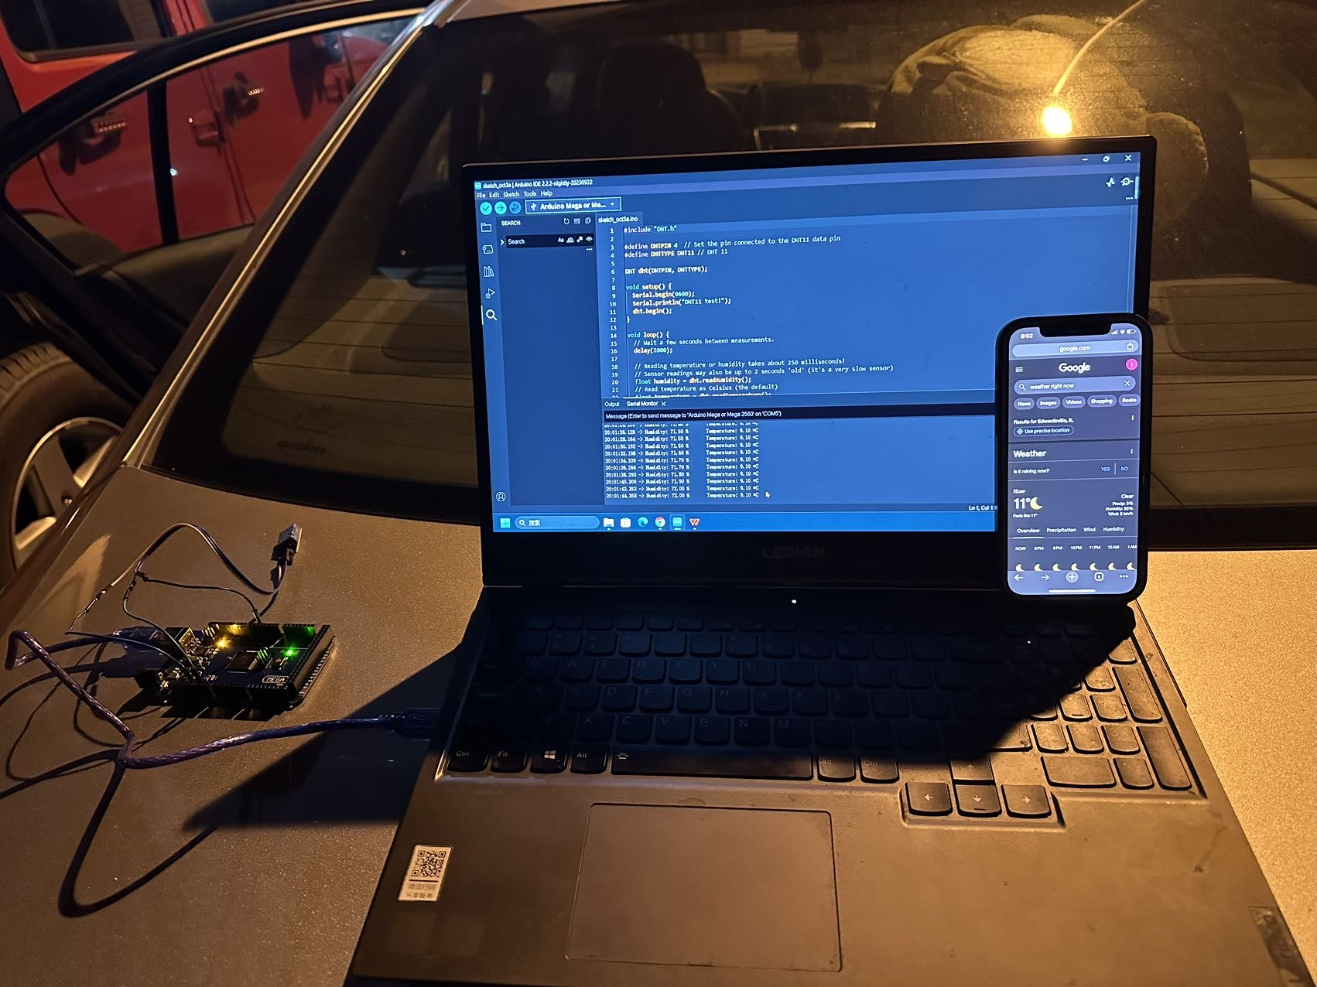
Measurement Process and Ground Truth
10
As for how to measure, the method I choose is to use the car air conditioning, and because the car has a more accurate temperature sensor that could serve as the ground truth and thus can be compared with the temperature measured by the DHT-11 sensor. The characteristics I choose to measure are drift, static error and linearity. Therefore, there is no need to use a very low temperature, and the car air conditioning is fully competent for this job In the car, we can turn on the automatic mode of the air conditioner, and when the specified temperature is reached, the air conditioner will stop, and we can use the sensor to measure
Testing Setup

Slide 11
11
Rundown of characteristics measurement process , Data collected , Findings and Analysis

Slide 12
12
Drift
For drift, we put the sensor outside to measure the temperature of the day and check the temperature of the day according to the phone. And keep the sensor running for one minute ,we can get under data.
the temperature is still 11*C
19:58:54.085 -> Humidity: 66.50 Temperature: 10.20 *C
19:58:56.110 -> Humidity: 66.60 % Temperature: 10.20 *C
19:58:58.156 -> Humidity: 66.70 % Temperature: 10.20 *C
19:59:00.187 -> Humidity: 66.80 % Temperature: 10.20 *C
19:59:02.215 -> Humidity: 66.80 % Temperature: 10.20 *C
19:59:04.229 -> Humidity: 66.80 % Temperature: 10.20 *C
19:59:06.269 -> Humidity: 66.90 % Temperature: 10.10 *C
19:59:08.287 -> Humidity: 67.00 % Temperature: 10.10 *C
19:59:30.593 -> Humidity: 67.80 % Temperature: 9.90 *C
we can see that when we keep the input to be 11, but the measure temperature is still changing.

Slide 13
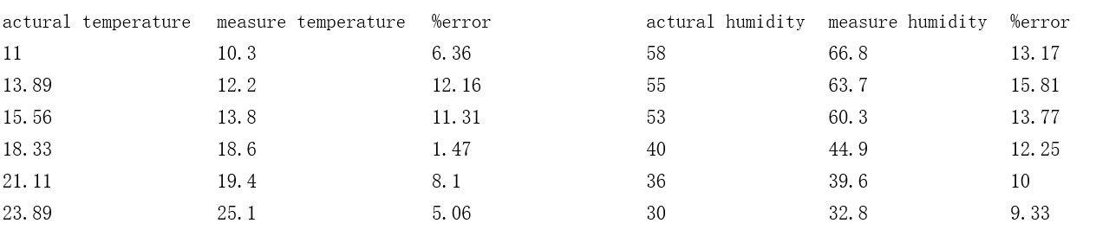
13
Static Error
Keep the temperature inside the car at () °C, then use DHT-11 to get the output, and compare with the vehicle thermometer reading, repeat for 3 groups

Slide 14
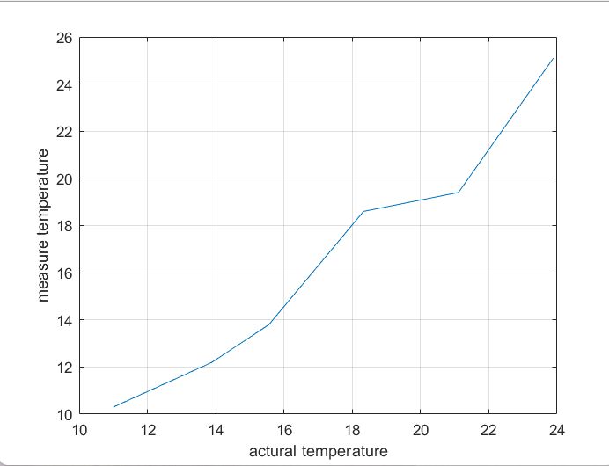
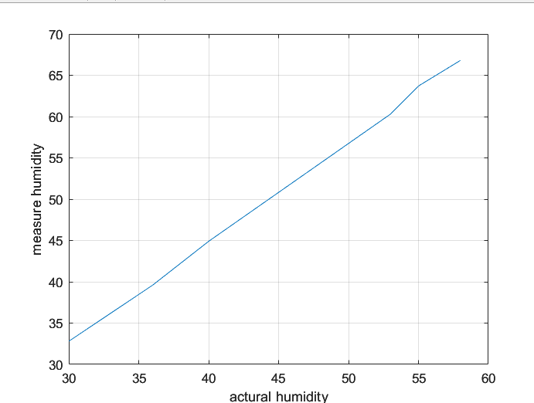
Linearity
14
For linearity, we adjust the temperature in the car to a certain value, then put the sensor in the car, and read a stable output after a period of time. Changing the temperature inside the car was repeated six times, and we chose to use MATLAB to draw the graph to observe whether it was linear

Slide 15
15
Summary of Findings
Temperature adds up everywhere which is why the first time we tried measuring , our readings were off by a considerable amount which we did not know at that time was out body temperature
It took about 10 mins for the sensor to go from the previous temperature to the new temperature(this is where most of the lack of the sensor was coming from
The longer the sensor stayed at a temperature the more the drift!

Slide 16
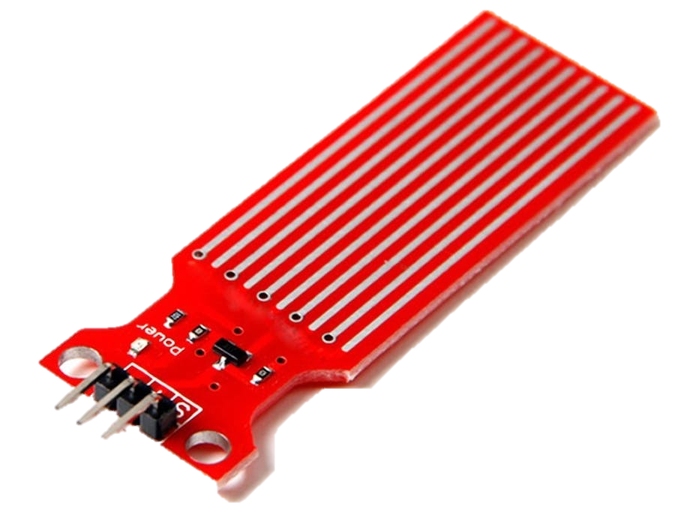
Water level Detection sensor
16
Important Characteristics and Specs Table
The Water Level Detection Sensor very self-descriptive as it does what it says it does: detect water level. It features ten copper wires in which 5 are sense traces and the remaining five are power traces
Sensor Type | Analog
Detection Area | 40mm * 16mm
Operating temperature | 10℃-30℃ Humidity: 10% -90% non-condensing
Working Principle
The sensor produces an output voltage proportional to the resistance; by measuring this voltage, the water level can thus be determined, measured and thus displayed!

Slide 17
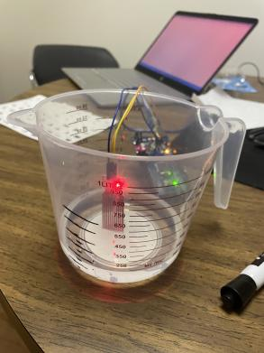
Measurement Process and Ground Truth
17
The ground truth was not only easily accessible but also easy to measure. We used a tape rule to measure and mark the ground truths of the length on transparent cup, we then went on to fill water to those levels and used the sensor to once again confirm the ground truth.
Testing Setup

Slide 18
18
Static Characteristics Measurement Process
Sensitivity/Linearity
Range
To measure the range, we submerged the sensor in water and gradually increase the depth until it no longer detected water. We then compared this to the range specified by the data sheet
To measure sensitivity, we slowly increased the water level while observing the sensor’s output. We did this till we obtained multiple readings, plotted it and then extracted the data we needed to quantify these characteristics
Resolution
Precision, Accuracy and Repeatability
As mentioned in the proposal, we tried to measure resolution, and to do this we tried making small incremental changes in water level and observing the corresponding changes in the sensor’s output. We found this really hard as the uncertainty was once again to high to ignore
To measure this, we obtained multiple readings at same water level (with the water level already premeasured) and then used Excel to calculate the standard deviation of the readings from each other and the ground truth.

Slide 19
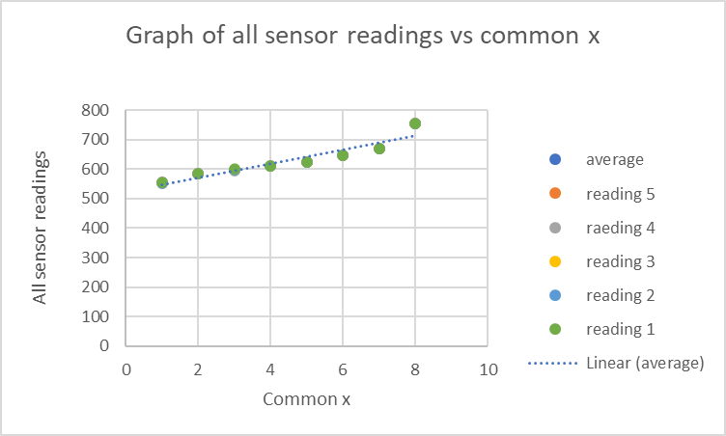
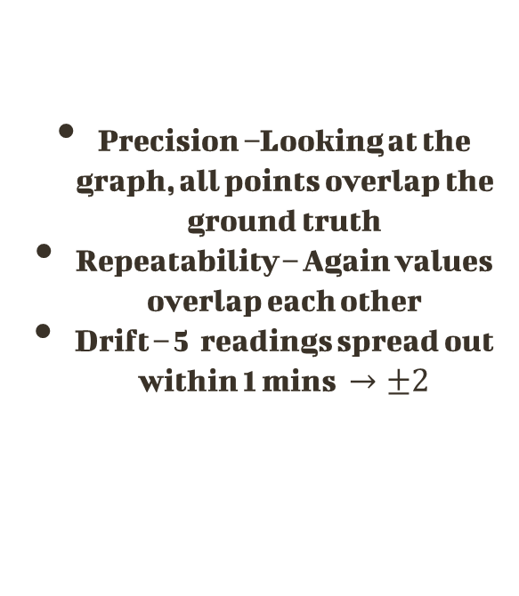
19
Data collected, Findings and Analysis
Precision –Looking at the graph, all points overlap the ground truth
Repeatability – Again values overlap each other
Drift – 5 readings spread out within 1 mins $→±2$

Slide 20
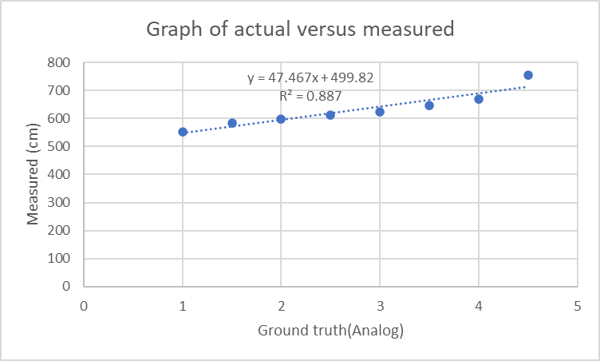
20
Data collected, Findings and Analysis
Linearity R^2 = 0887. This shows that the graph is not as linear as we would want it to be but this is to be expected due to the fluctuations
Range –Accurate within the manufacture spec ( 1.6 - 4cm)
Resolution: Cannot be quantified due to the error we observed during testing
Sensitivity: Slope =47.467

Slide 21
Comparison and Summary of Findings
21
 | Sensor Analog Readings
True Value(cm | 1 | 2 | 3 | 4 | 5 | Average | Std | Deviation | Error
1 | 554 | 553 | 553 | 554 | 554 | 553.6 | 0.547723 | 1 | 55260
1.5 | 585 | 584 | 584 | 584 | 585 | 584.4 | 0.547723 | 1 | 38860
2 | 600 | 597 | 597 | 596 | 597 | 597.4 | 1.516575 | 4 | 29770
2.5 | 612 | 612 | 610 | 610 | 612 | 611.2 | 1.095445 | 2 | 24348
3 | 625 | 625 | 625 | 625 | 625 | 625 | 0 | 0 | 20733.33
3.5 | 648 | 648 | 648 | 648 | 647 | 647.8 | 0.447214 | 1 | 18408.57
4 | 669 | 669 | 669 | 669 | 669 | 669 | 0 | 0 | 16625
4.5 | 755 | 754 | 754 | 755 | 754 | 754.4 | 0.547723 | 1 | 16664.44
From the data to the side, we can conclude a lot of things but the most important things we need to focus is that the data matches the data sheet especially the range
Water waves made the readings fluctuate before stabilizing which took about 20seconds decreasing the linearity of the sensor

Slide 22
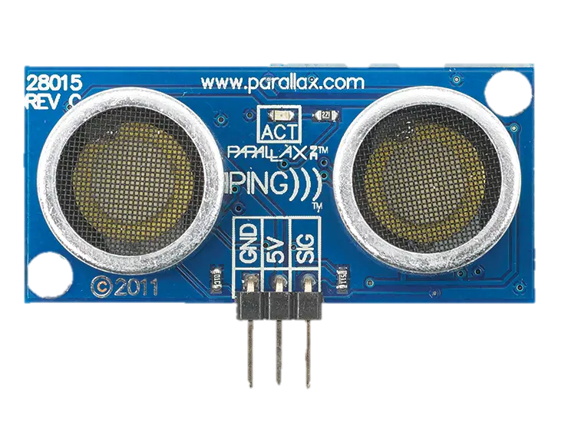
Ultrasonic Module
22
Important Characteristics and Specs Table
The HS-SR04 is a proximity sensor. It features two ultrasonic transducers. One is transmitter which outputs ultrasonic sound pulses and the other is receiver which listens for reflected waves. Its primary purpose is to measure distance
Range | 2cm – 400cm (Practically 80cm)
Accuracy | ± 3mm
Resolution | 0.3cm
Sensitivity | -65dB min
Working Principle
It uses the echo time method to detect the time of ultrasonic round trip to the measured distance.

Slide 23
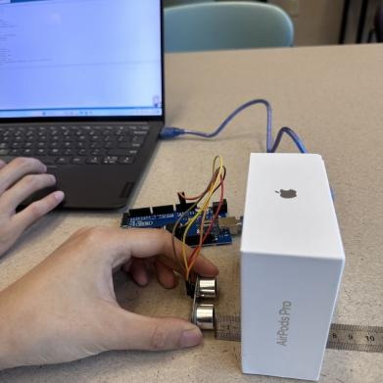
Measurement Process and Ground Truth
23
The ground truth was not only easily accessible but also easy to measure. We used a ruler and a tape rule at two different instances to measure the ground truth and then set up the sensor and an obstacle in a way that we could increase and decrease distance as needed. See below
Testing Setup

Slide 24
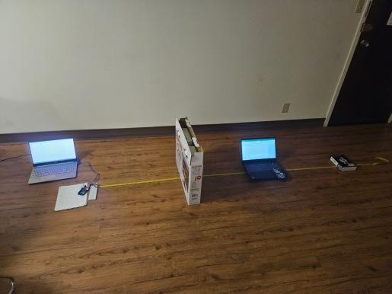
24
Static Characteristics measurement process
Range
Sensitivity
First, we put the sensor and the object together, at which point the measurement distance is too small to be beyond the sensor‘s measurable range, so the readings are approximately infinite. Then we slowly move the object away until a recognizable reading appears, which we use as the minimum value of the sensor. Then we gradually move the object away from the sensor in units of 10cm, and when the reading shows infinity again, the description is beyond the maximum range, and then we gradually move the object closer to the sensor in 1cm units to find the critical point where the reading can be identified and the reading is approximately infinite. This distance was then considered the maximum value that the sensor can measure.
The sensor in different distance several times, The measured data was then averaged and compared with the actual distance. Then the measured distance and the actual distance are used as horizontal and vertical coordinates to plot their functions.

Slide 25
25
Quick run though of measurement process
Resolution
Accuracy, Precision Reliability
We tried this by setting the sensor at a premeasured distance and with the ruler in between the sensor and the object, we tried adjusting the distance in increments of 0.1cm till we start getting a discernable output from the sensor. But the data was not reliable due to too much uncertainty which you can observe in the deviation
For this we just took multiple readings of different distances, plotted the values against each other and extracted the data we needed to qualify and quantify these characteristics as can be seen in the next slide .

Slide 26
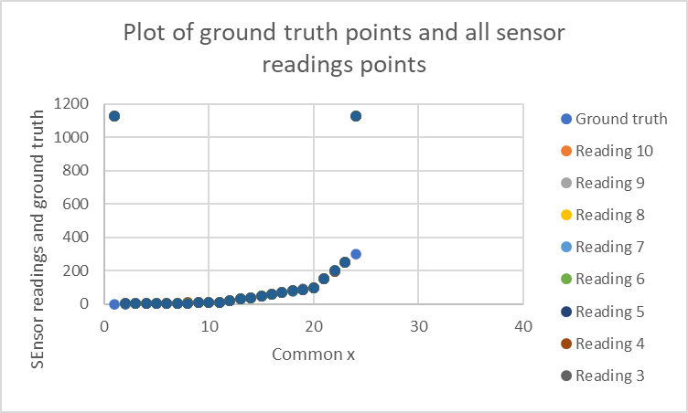
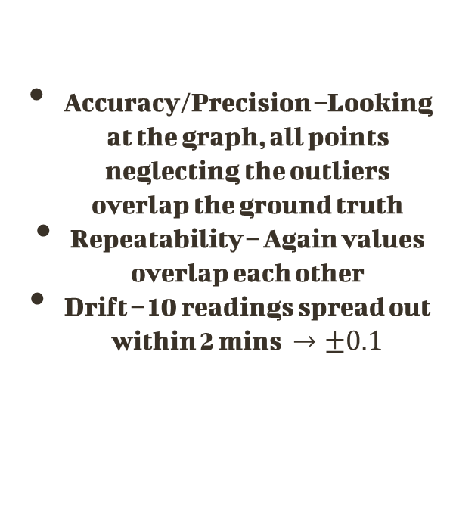
26
Data collected, Findings and Analysis
Accuracy/Precision –Looking at the graph, all points neglecting the outliers overlap the ground truth
Repeatability – Again values overlap each other
Drift – 10 readings spread out within 2 mins $→±0.1$

Slide 27
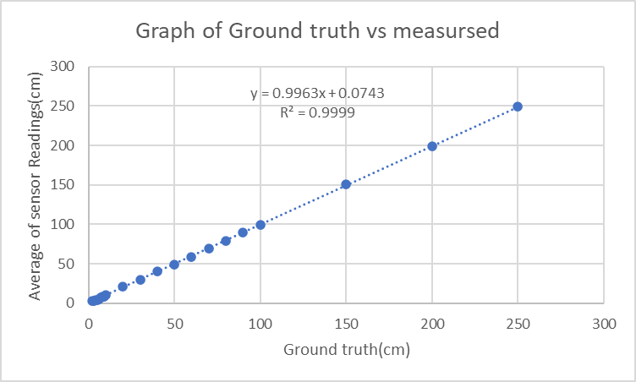
27
Data collected, Findings and Analysis
Linearity R^2 = 0.9999, Also the equation of the graph is linear
Range –Accurate within the manufacture spec (2 – 250cm)
Resolution: Cannot be quantified due to the error we observed during testing
Sensitivity: Slope = 0.9963

Slide 28
Comparison and Summary of Findings
28
 | Sensor Readings
Ground Truth(cm | 1 | 2 | 3 | 4 | 5 | 6 | 7 | 8 | 9 | 10 | Average | Std | Deviation | % Error
0 | 1126.03 | 1126.07 | 1126.12 | 1126.19 | 1126.36 | 1126.91 | 1126.88 | 1126.17 | 1126.17 | 1126.03 | 1126.293 | 0.33143 | 0.88 | #DIV/0!
1 | 4.09 | 4.09 | 3.98 | 3.98 | 3.98 | 4.03 | 4.09 | 4.09 | 4.09 | 4.09 | 4.051 | 0.052377 | 0.11 | 305.1
2 | 2.88 | 2.76 | 2.88 | 2.86 | 2.86 | 2.88 | 2.88 | 2.86 | 2.78 | 2.86 | 2.85 | 0.043461 | 0.12 | 42.5
3 | 3.17 | 3.07 | 3.12 | 3.07 | 3.17 | 3.17 | 3.17 | 3.17 | 3.17 | 3.17 | 3.145 | 0.042492 | 0.1 | 4.833333
4 | 4.09 | 3.98 | 4.09 | 4.09 | 3.98 | 3.98 | 4.09 | 4.09 | 4.09 | 3.98 | 4.046 | 0.056804 | 0.11 | 1.15
5 | 4.59 | 4.69 | 4.71 | 4.69 | 4.59 | 4.69 | 4.71 | 4.69 | 4.69 | 4.59 | 4.664 | 0.051683 | 0.12 | -6.72
6 | 5.6 | 5.6 | 5.6 | 5.6 | 5.5 | 5.62 | 5.5 | 5.5 | 5.62 | 5.5 | 5.564 | 0.055618 | 0.12 | -7.26667
7 | 7.33 | 7.45 | 7.34 | 7.44 | 7.33 | 7.33 | 7.45 | 7.33 | 7.43 | 7.36 | 7.379 | 0.055668 | 0.12 | 5.414286
8 | 8.36 | 8.34 | 8.24 | 8.24 | 8.24 | 8.24 | 8.36 | 8.24 | 8.36 | 8.24 | 8.286 | 0.059666 | 0.12 | 3.575
9 | 8.93 | 9.02 | 8.91 | 9.03 | 8.93 | 9.02 | 8.91 | 9.02 | 8.91 | 9.02 | 8.97 | 0.055377 | 0.12 | -0.33333
10 | 10.24 | 10.24 | 10.34 | 10.34 | 10.34 | 10.22 | 10.34 | 10.33 | 10.33 | 10.33 | 10.305 | 0.049944 | 0.12 | 3.05
20 | 20.86 | 20.86 | 20.86 | 20.84 | 20.84 | 20.84 | 20.74 | 20.74 | 20.74 | 20.84 | 20.816 | 0.053166 | 0.12 | 4.08
30 | 30.28 | 30.28 | 30.28 | 30.28 | 30.38 | 30.38 | 30.29 | 30.28 | 30.28 | 30.28 | 30.301 | 0.041753 | 0.1 | 1.003333
40 | 40.21 | 40.21 | 40.21 | 40.21 | 40.22 | 40.12 | 40.1 | 40.12 | 40.1 | 40.21 | 40.171 | 0.053009 | 0.12 | 0.4275
50 | 49.24 | 49.24 | 49.24 | 49.24 | 49.24 | 49.26 | 49.26 | 49.26 | 49.34 | 49.36 | 49.268 | 0.044422 | 0.12 | -1.464
60 | 59.19 | 59.29 | 59.07 | 59.29 | 59.19 | 59.29 | 59.71 | 59.28 | 59.29 | 59.07 | 59.267 | 0.178889 | 0.64 | -1.22167
70 | 69.12 | 69.12 | 69.12 | 69.12 | 69.21 | 69.22 | 69.12 | 69.22 | 69.12 | 69.21 | 69.158 | 0.049171 | 0.1 | -1.20286
80 | 79.05 | 79.36 | 79.06 | 79.05 | 79.35 | 79.45 | 78.53 | 79.36 | 78.97 | 78.93 | 79.111 | 0.278147 | 0.92 | -1.11125
90 | 89.38 | 89.36 | 89.36 | 89.4 | 89.29 | 89.4 | 89.36 | 89.38 | 89.36 | 89.48 | 89.377 | 0.047621 | 0.19 | -0.69222
100 | 99.31 | 99.43 | 99.41 | 99.33 | 99.41 | 99.33 | 99.31 | 99.47 | 99.33 | 99.41 | 99.374 | 0.057966 | 0.16 | -0.626
150 | 150.34 | 150.28 | 150.69 | 150.38 | 150.36 | 150.36 | 150.81 | 150.38 | 150.78 | 150.38 | 150.476 | 0.200344 | 0.53 | 0.317333
200 | 199.1 | 199.12 | 199.1 | 198.69 | 198.6 | 199.12 | 199.14 | 199.12 | 198.74 | 199.05 | 198.978 | 0.211912 | 0.54 | -0.511
250 | 249.47 | 249.64 | 249.78 | 249.48 | 250.29 | 249.34 | 249.4 | 249.78 | 249.31 | 249.69 | 249.618 | 0.292567 | 0.98 | -0.1528
300 | 1124.55 | 1124.65 | 1126.45 | 1126.45 | 1126.55 | 1126.56 | 1124.45 | 1124.45 | 1124.67 | 1124.89 | 1125.367 | 0.985743 | 2.11 | 275.1223
 |  |  |  |  |  |  |  |  |  |  |  | 0.139551 | 0.36125 | 27.18571
 |  |  |  |  |  |  |  |  |  |  |  | 0.09427 | 0.265238 | 2.14519
From the data to the side, we can conclude a lot of things but the most important things we need to focus is that the data matches the data sheet at the beginning of this section

Slide 29
29
Conclusion
The sensors were not up to industry standard but they do what they are supposed to do and this here we come in – to make up for that gap with our time and effort .
The sensors are not that crappy and we lost time focusing on that but at the end of the day we realized what we had to do!

Slide 30
30
Thank You
Q/A

